Slide 1

Emily Schmidt
Go-to-Market Plan
Enabling an AI-Powered Customer Service Experience on Mobile
Product Management Project

Slide 2
Goals
Increase CLV
Reduce Churn
Increase Engagement
Business
Be the most desirable eCommerce Platform
Marketing
Encourage busy buyers to see
the brand as a way to simplify their lives
Communications

Slide 3
KPIs
Measuring Success
Primary KPI
10% reduction in overall churn
Secondary KPIs
30% chat adoption
5 pts increase in CSAT
10% faster first contact resolution
15-20% reduction in avg. resolution time
Operational Impact
15-20% decrease in call center vol.
15-20% decrease in cost per interaction
Guardrails
App crash / error rate below baseline
No increase in complaints or escalations
Support wait times maintained or improved

Slide 4

Market Overview
By knowing about business now you can do know your own business now
AI in eCommerce is projected to grow over 600%, reaching $64.03B
Over 78% of eCommerce activity is driven through mobile app engagement
Demand is rising for in-context transactions

Slide 5
Competitor Review
 | Our Product | Amazon | Shop
AI Quick Solutions | In-chat guided workflows for common requests and issue resolution | In-chat guided workflows for common requests and issue resolution | AI assistant responds conversationally without guided prompts
Chat Button | Chat button prominently placed on home screen | Chat/support accessed through orders or settings pages | Home-screen chat focused on shopping assistance
Talk to CSR | Seamless escalation to live customer service representatives | Limited live support availability | No embedded CSR escalation; users must contact support separately
Machine-Learning | Phase 2 | Likely integrated across recommendation and support systems | Likely integrated across shopping and recommendation experiences
Zero-Click Purchase | Phase 2 | “Buy Now” functionality embedded across products | AI-powered shopping assistant experience
Our competitors already have an in-app feature that guides customers to self-serve or chat directly with a customer service representative.
Shopflow must keep up and offer unique features to stay competitive and faster, more personalized service our customers.

Slide 6

Target Audience
Millennial, urban professionals with high spending power who stay ahead of trends and live fast-paced lives.
Who are they?
Quick access to what matters so they can stay on top of life without slowing down.
What do they need?
Encourage them to use the mobile app so they can shop whenever, wherever with ease and piece of mind
How do we talk to them?

Slide 7
Messaging
Tagline
Short boilerplate
Support That Moves at Your Speed
Shopora delivers AI-powered, human-centered customer support that helps busy consumers resolve issues faster through seamless in-app assistance and guided workflows.
USP 1 | USP 2 | USP 3 | USP 4
Human-Centric AI AI should remove friction — not human connection. Customers can seamlessly escalate to live support whenever needed. | Intuitive Support Access Support is visible, recognizable, and immediately accessible from the home screen — eliminating the frustration of searching for help. | Simplified Requests Customers can start returns, order support, and common requests in seconds through guided workflows that reduce effort and save time. | Smarter Support Over Time Customers benefit from increasingly personalized and proactive support experiences as the platform evolves with AI &ML.

Slide 8
Channel Plans
Channel | Description | Estimated budget
Mobile App | Mobile engagement continues to grow across both the market and our customer base, making the mobile app the highest-impact channel for customer adoption and support accessibility. | $35,000–$70,000
Website | Extending the experience to the website ensures a consistent omnichannel support journey and reinforces familiarity across customer touchpoints. | $10,000–$25,000
Help Line | Promoting the in-app chat experience during support calls encourages adoption of faster, self-guided service workflows while preserving access to live agents when needed. | $6,000–$15,000
Email Communications | Educates customers about the new support experience and benefits before issues arise. | $2,000–$5,000

Slide 9
Operations Enablement
Activity | Objective | Target Audience | Marketing Channels
Integration Catalog Launch | Make Salesforce, HubSpot, Zendesk, Shopify, Freshdesk, and Intercom self-serve to compress time-to-value to <30 days | Solutions Engineers (internal), RevOps and IT admins (customer-side) | Partner marketplaces (Salesforce AppExchange, Shopify App Store, Zendesk Marketplace), integration landing pages, partner co-marketing
Live Agent Handoff Playbook | Standardize escalation rules and agent desktop deployment so customers retain CSAT after handoff | Contact center operations leaders, WFM managers | Webinars with CCaaS partners, joint solution briefs, conference workshops (Customer Contact Week, ICMI)

Slide 10
Operations Enablement
Activity | Objective | Target Audience | Marketing Channels
Trust, Security & Compliance Launch | Unblock enterprise deals with SOC 2 Type II, EU data residency, and AI disclosure standards | CISOs, procurement, legal/privacy counsel | Trust center, security whitepapers, analyst validation reports, RFP response library
Insights & Performance Dashboard Launch | Provide visibility into adoption, customer sentiment, churn indicators, and service performance metrics | Product, Operations, Executive Leadership | Executive dashboards, KPI reporting cadences, operational reviews

Slide 11
Release Plan
JULY 2027
AUGUST 2027
OCTOBER 2027
JANUARY 2028
MVP Pilot Launch
Pilot Optimization & Stabilization
Full MVP Launch
Phase 2 Expansion & AI Optimization

Slide 12
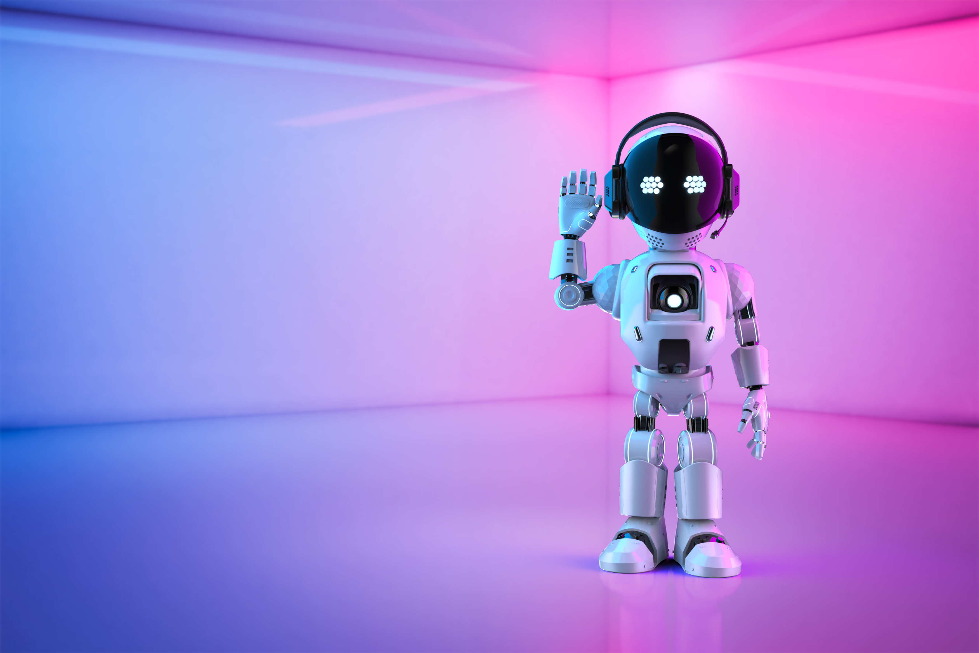
Thank You!

